Slide 1














LIVE PROJECT
By
Dhruv Choudhury | 11021210069
Shreya | 11021210078
Yadukrishnagiri | 11021210079
Srijan Telang | 11021210081

Slide 2
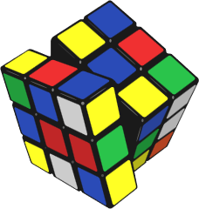
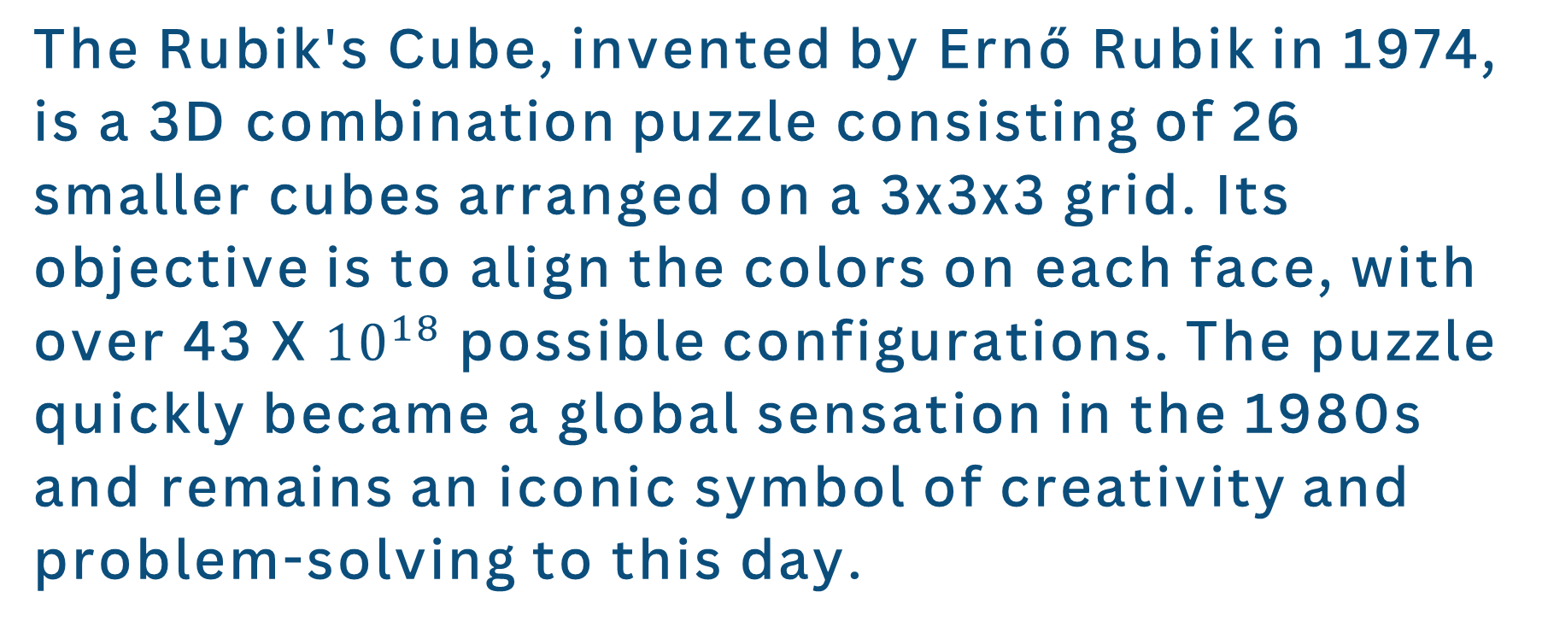
INTRODUCTION: RUBICS CUBE SOLVER USING CV2 AND KOCIEMBA
The Rubik's Cube, invented by Ernő Rubik in 1974, is a 3D combination puzzle consisting of 26 smaller cubes arranged on a 3x3x3 grid. Its objective is to align the colors on each face, with over 43 X${10}^{18}$ possible configurations. The puzzle quickly became a global sensation in the 1980s and remains an iconic symbol of creativity and problem-solving to this day.

Slide 3

OVERVIEW OF COMPUTER VISION (CV2) AND ITS APPLICATIONS
Computer Vision (CV2) Overview:
- CV2: A field of artificial intelligence focused on enabling computers to interpret and understand visual information from the real world.
- Applications:
1. Object detection and recognition.
2. Image classification and segmentation.
3. Facial recognition and emotion detection.
4. Optical character recognition (OCR).
5. Autonomous vehicles and robotics.
- Enables machines to perceive, analyze, and respond to visual data, revolutionizing various industries such as healthcare, automotive, security, and entertainment.

Slide 4
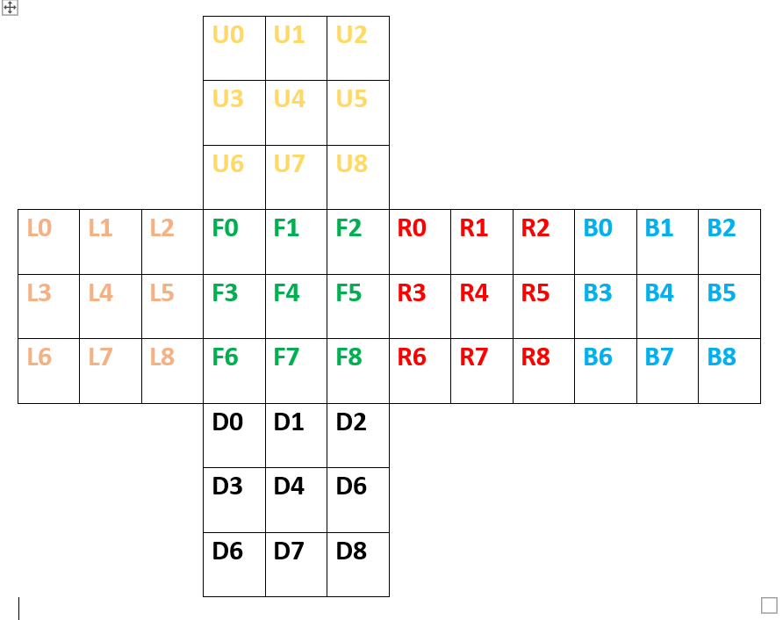
INTRODUCTION TO KOCIEMBA ALGORITHM FOR RUBIK'S CUBE SOLVING
Kociemba Algorithm Introduction:
- Named after Herbert Kociemba, a German mathematician.
- A two-phase algorithm for solving Rubik's Cube optimally.
- Utilizes group theory and mathematical algorithms.
- Breaks down solving process into smaller, more manageable steps.
- Known for its efficiency and ability to find optimal solutions quickly.
- Widely used in Rubik's Cube-solving software and competitions.

Slide 5

RUBICS CUBE SOLVER USING CV2 AND KOCIEMBA
STEP 1: SCANNING THE CUBE
USE COMPUTER VISION TECHNIQUES TO SCAN AND CAPTURE THE CURRENT STATE OF THE RUBIK'S CUBE, GATHERING DATA FOR FURTHER PROCESSING.
STEP 2: PROCESSING THE DATA
IMPLEMENT IMAGE PROCESSING ALGORITHMS TO ANALYZE THE SCANNED DATA AND EXTRACT THE ARRANGEMENT OF COLORED STICKERS ON EACH FACE OF THE CUBE.
STEP 3: APPLYING KOCIEMBA ALGORITHM
UTILIZE THE KOCIEMBA ALGORITHM TO GENERATE A SEQUENCE OF MOVES THAT WILL SOLVE THE RUBIK'S CUBE FROM ITS CURRENT STATE TO THE SOLVED STATE.

Slide 6
Two-Phase Approach
The Kociemba algorithm operates in two phases:
Phase 1: The goal is to solve the cube to a state that meets a specific property, known as the G1 state. In this state, the orientation of the edge and corner pieces cannot change, and the pieces in the U (upper) and D (down) layers cannot move out of these layers. This phase uses a subset of moves that includes rotations of the middle layer and 180-degree turns of the other layers.
Phase 2: Once the cube is in the G1 state, the algorithm solves the rest of the cube using a different set of moves that preserve the G1 state until the cube is fully solved
Iterative Deepening
The algorithm employs a technique called iterative deepening to find the shortest solution. It starts with a maximum number of moves and systematically searches for solutions that use fewer moves. If a shorter solution is found, it updates the maximum number of moves and continues the search until it can no longer find a shorter solution.

Slide 7
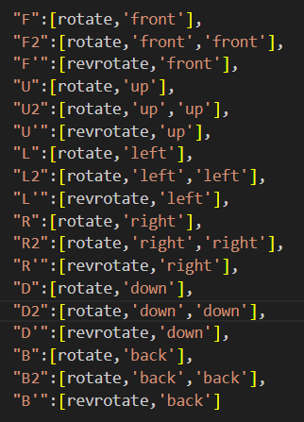
Operations performed by Kociemba :
F : Front
U : Up
L : Left
R : Right
D : Down
B : Back
_‘_ : Anticlockwise Rotation (revrotate)
___: Clockwise Rotation (rotate)
The Kociemba algorithm is a powerful tool for solving the Rubik’s Cube and is used in various cube-solving software due to its ability to find solutions that are close to the optimal number of moves. It’s a testament to the fascinating intersection of computer science, mathematics, and the world of twisty puzzles.

Slide 8
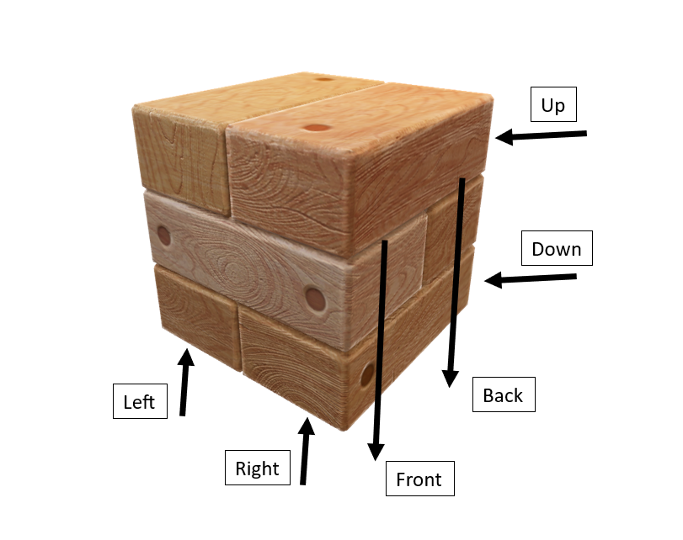
Clockwise Rotation:
Left Operation
OLD | F0 | F3 | F6 | D0 | D3 | D6 | B2 | B5 | B8 | U0 | U2 | U6
NEW | U0 | U3 | U6 | F0 | F3 | F6 | D6 | D3 | D0 | D8 | D5 | D2

Slide 9
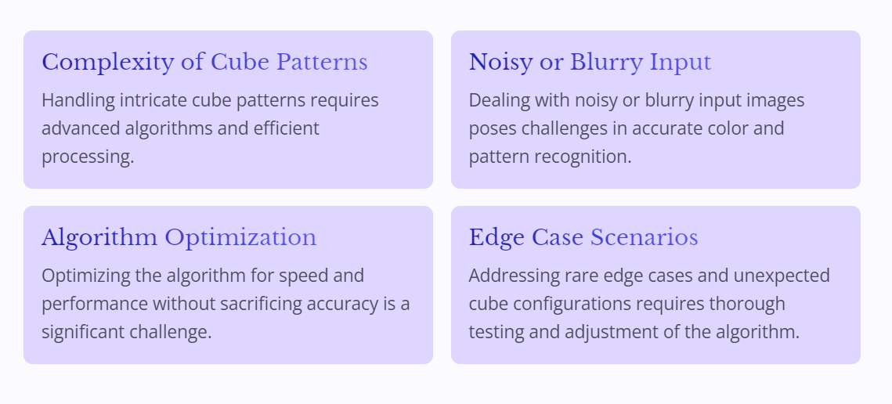
CHALLENGES AND SOLUTIONS IN DEVELOPING THE SOLVER ALGORITHM

Slide 10
VISUALIZING THE SOLVER PROCESS: DEMONSTRATION AND EXAMPLES
DEMONSTRATION IN ACTION
Step-by-Step Visualization
REAL-WORLD EXAMPLES
Witness the Rubik’s Cube solver algorithm in action, solving the complex puzzle with precision and speed.
Step through the solution process visually, from the initial state to the final solved configuration.
Explore real-life examples of the Rubik’s Cube solver in practical and competitive settings.

Slide 11
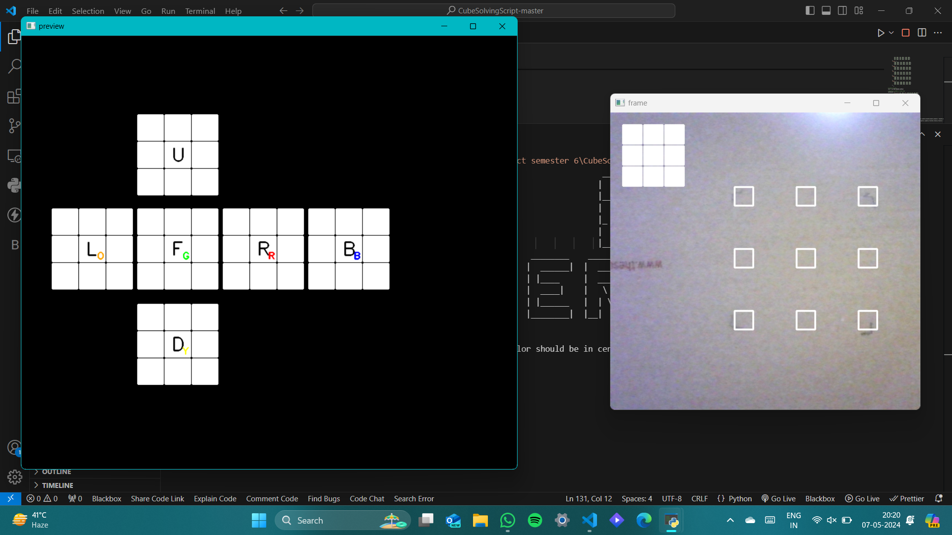

Slide 12
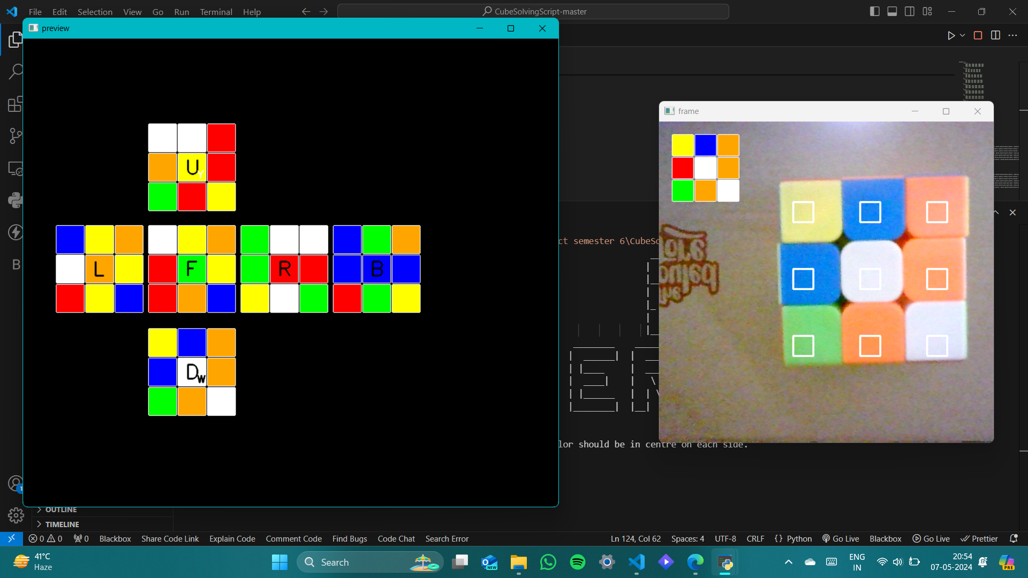

Slide 13
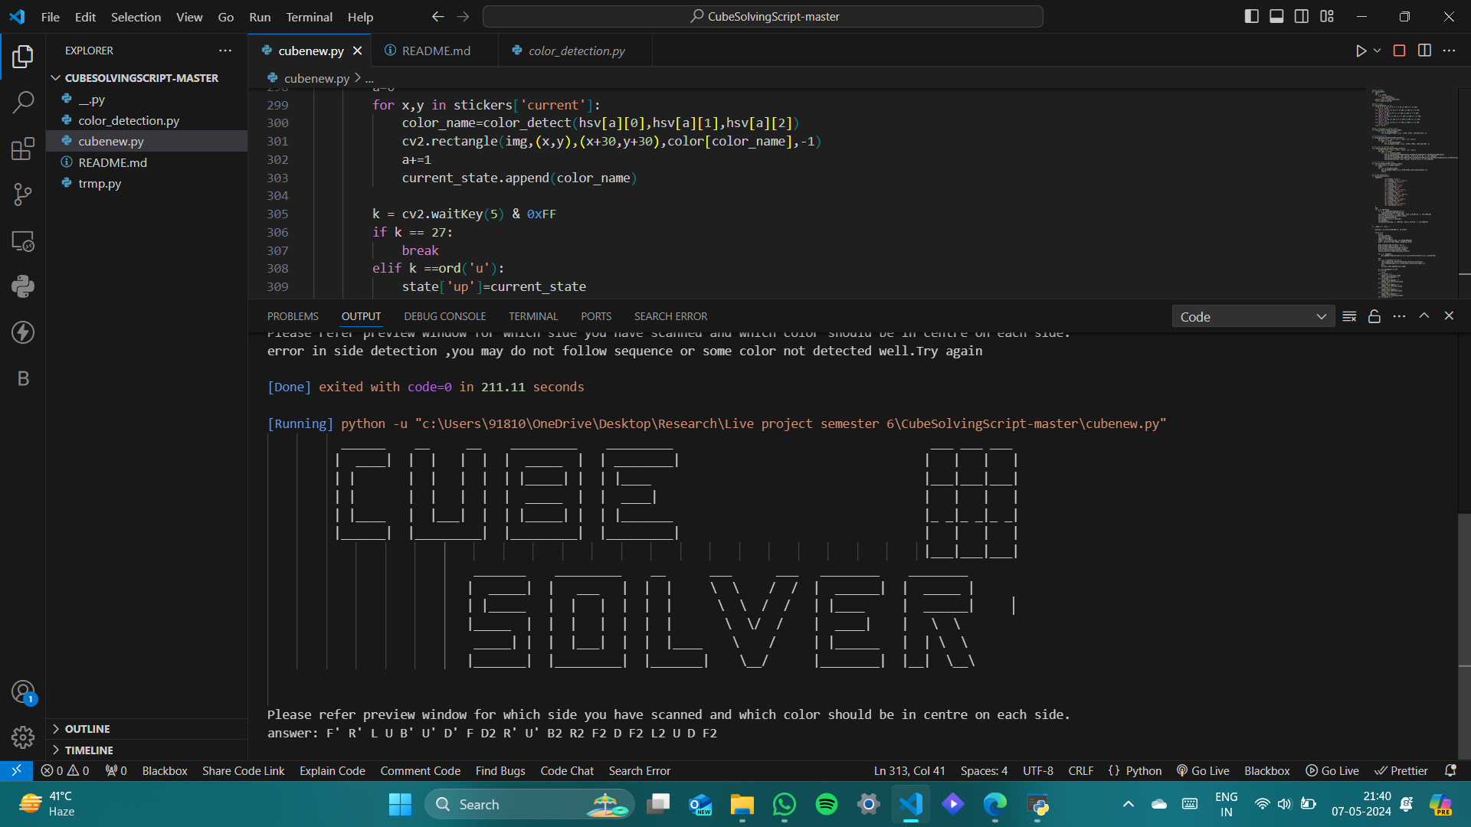

Slide 14
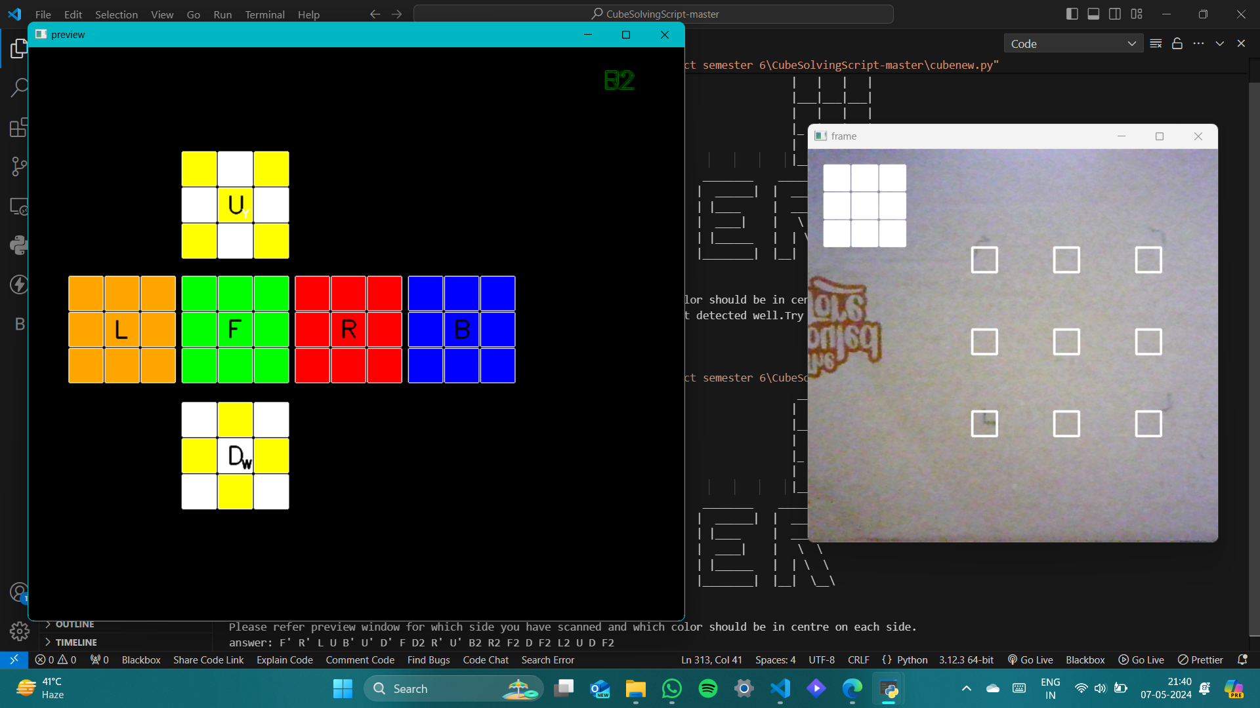

Slide 15


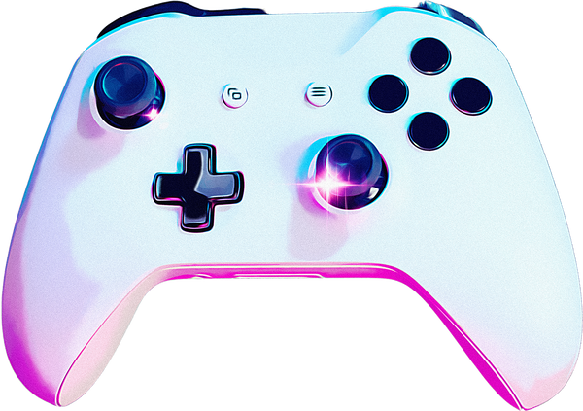

REAL-WORLD APPLICATIONS AND IMPLICATIONS
ROBOTICS
Gaming
Education
Rubik's Cube solvers contribute to robotic manipulation and dexterity, showcasing the potential of AI and mechanical control in modern robotics.
Integration of Rubik's Cube solving into gaming platforms fosters cognitive challenges and problem-solving skills in an interactive and engaging manner.
In educational settings, the Rubik's Cube promotes spatial reasoning, critical thinking, and algorithmic understanding, enhancing student engagement and proficiency in STEM subjects.

Slide 16
THANK YOU !!

